Slide 1
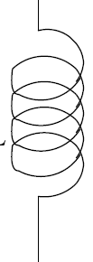
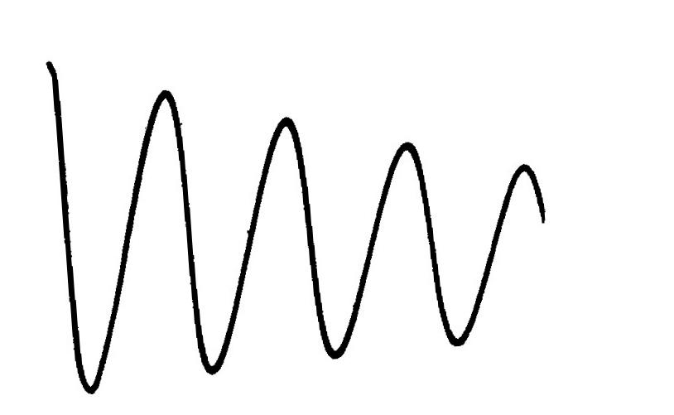
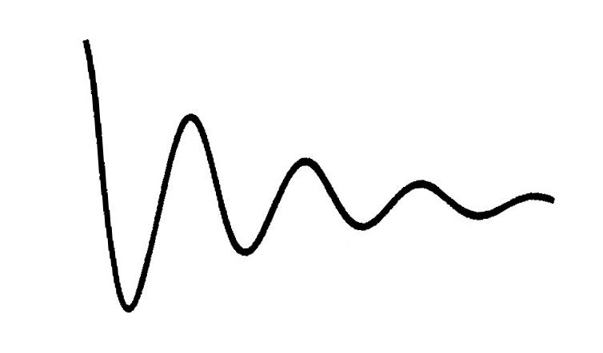
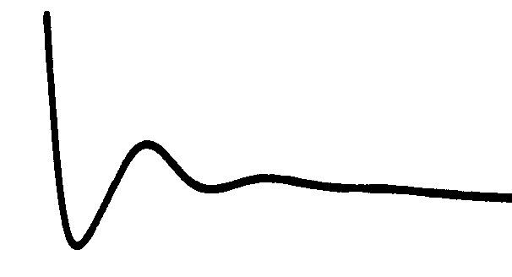
Example: Current transient LCR circuit
C
r
L
output
S
R
β₁
β₂
β₃
From Feynman
β₁< β₂< β₃

Slide 2
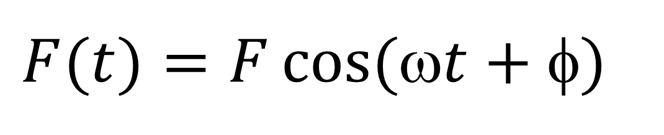
Forced Oscillation and resonance
SHO with an additional external force
$$F(t)=F\cos{(ωt+φ)}$$

Slide 3
Why this particular type of force ?
For any arbitrary time varying periodic force F(t)

Slide 4
Equation of motion for forced harmonic oscillators
Driving force

Slide 5
2nd order linear inhomogeneous differential equation
Solution of x(t) will be complex.

Slide 6
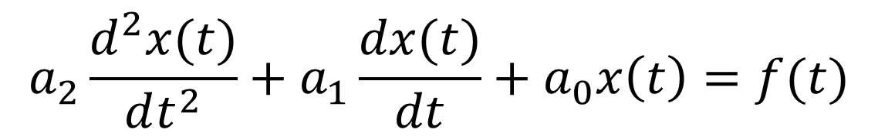
Solution to 2nd order linear inhomogeneous differential equation
$$a_{2}\frac{d^{2}x(t)}{dt^{2}}+a_{1}\frac{dx(t)}{dt}+a_{0}x\left(t\right)=f(t)$$
General solution :
Complementary function
Particular integral: obtained by special methods, solves the
equation with f(t)≠0; without any additional parameters
A & B : obtained from initial conditions

Slide 7
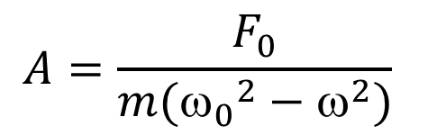
Obtaining the particular integral
Trial solution: Solution to SHO with driving frequency
Amplitude and Relative Phase
$$A=\frac{F_{0}}{m({ω_{0}}^{2}−ω^{2})}$$
for
for

Slide 8
Low Frequency Response
Stiffness Controlled Regime

Slide 9
High Frequency Response
Mass Controlled Regime

Slide 10
Resonance [ω = ω₀]
The amplitude diverges, phase changes across resonance

Slide 11
Forced oscillator with damping
In ‘complex’ method
Trial solution: Solution to SHO with driving frequency

Slide 12
(Amplitude)
(Phase)
(Amplitude Resonance)

Slide 13
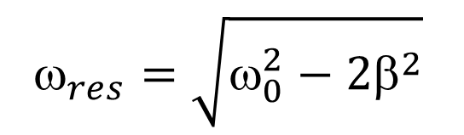
$$ _{res}=\sqrt{ω_{0}^{2}−{2β}^{2}}$$
Amplitude maxima (resonance)

Slide 14
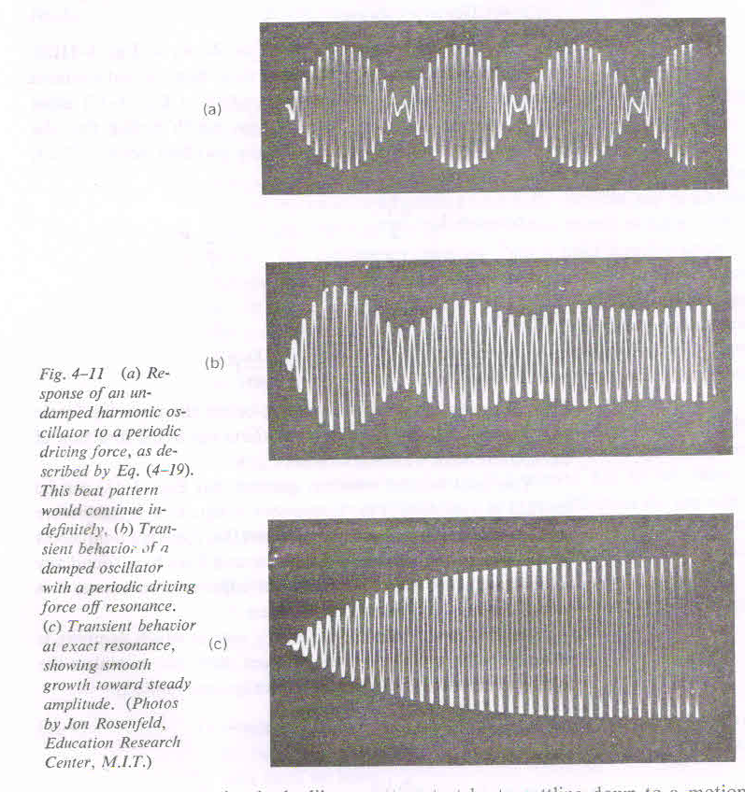
Importance of damping in achieving steady state
Undamped
Damped
Damped,
at resonance

Slide 15
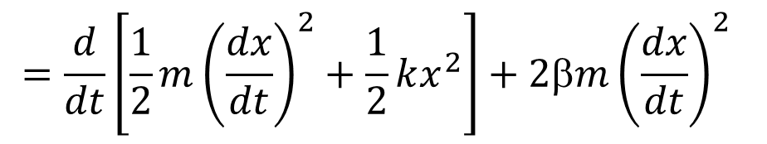
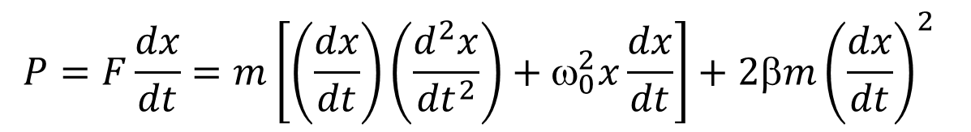
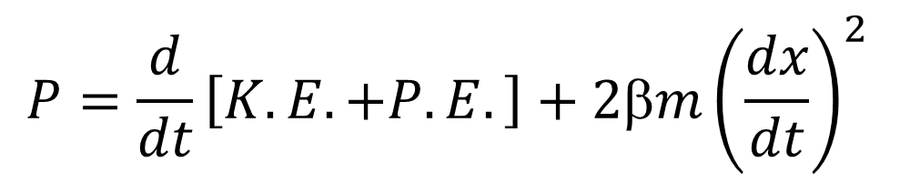
Work done by the force per second ≡ Power
$$P=F\frac{dx}{dt}=m\left[\left(\frac{dx}{dt}\right)\left(\frac{d^{2}x}{{dt}^{2}}\right)+ω_{0}^{2}x\frac{dx}{dt}\right]+2βm{\left(\frac{dx}{dt}\right)}^{2}$$
$$=\frac{d}{dt}\left[\frac{1}{2}m{\left(\frac{dx}{dt}\right)}^{2}+\frac{1}{2}kx^{2}\right]+2βm{\left(\frac{dx}{dt}\right)}^{2}$$
$$P=\frac{d}{dt}\left[K.E. +P.E.\right]+2βm{\left(\frac{dx}{dt}\right)}^{2}$$
Mechanical
Dissipative

Slide 16
Work done by the force per second ≡ Power
(Average Power)

Slide 17
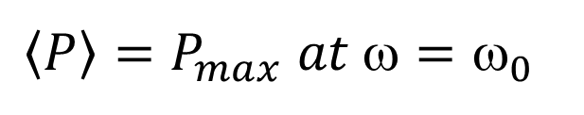
Power resonance
FWHM: 2β
$$\left\langle P\right\rangle =P_{max} at ω=ω_{0}$$

Slide 18
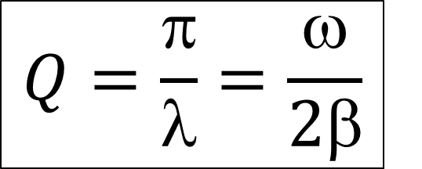
Efficiency of the oscillator: Quality factor
Mechanical energy per cycle
Work done by force per cycle
$$Q=\frac{π}{λ}=\frac{ω}{2β}$$
Q defines the sharpness of resonance curve

Slide 19
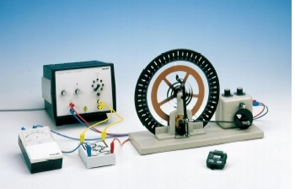
Pohl’s Pendulum
Forced and Damped Oscillation

Slide 20
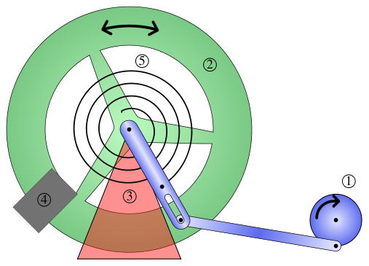
1. Stimulation motor 2. Rotating pendulum 3. Bearing block
4. Electromagnetic break 5. Spiral spring 6. Scale

Slide 21
Find frequency of oscillations with different damping current
Check: the frequency of oscillation should decrease with
increase in damping current.
2. In a semi log plot Check whether amplitude decreases
logarithmically with time
3. Check whether the maximum of resonance curve shifts
towards lower frequency with increasing in damping.
4. Check whether the width of the resonance curve is more with
higher damping current
5. Check the phase difference between the exciter and pendulum
--- much above resonance and much below the resonance.
Pohl’s Pendulum: Compare model SHO and Experiment

Slide 22
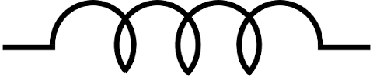
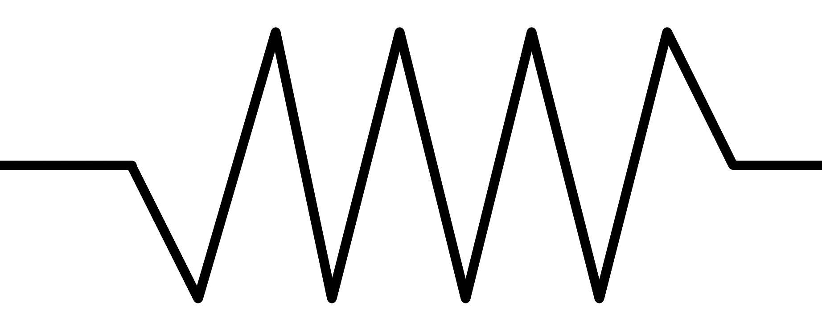
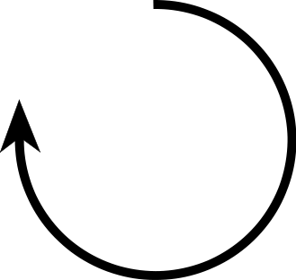
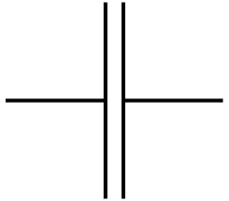

Example: Electric circuit
L
R
C
E(t)

Slide 23
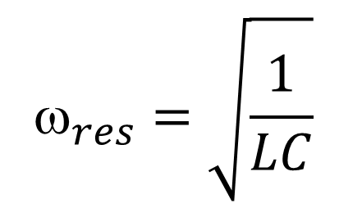
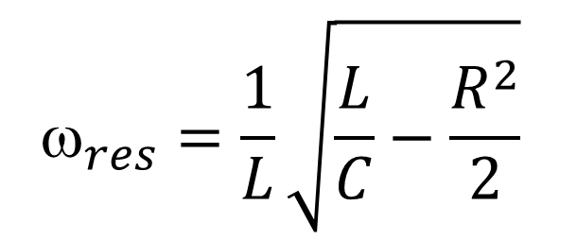
Example: Electric circuit
Amplitude resonance
Power resonance
$$ _{res}=\frac{1}{L}\sqrt{\frac{L}{C}−\frac{R^{2}}{2}}$$
$$ _{res}=\sqrt{\frac{1}{LC}}$$

Slide 24
Therefore,
Complex impedance of the circuit

Slide 25
Average Power of a LCR circuit
, γ=2β
At resonance: Z=Z_{min}=R, <P> =P_{max}

Slide 26
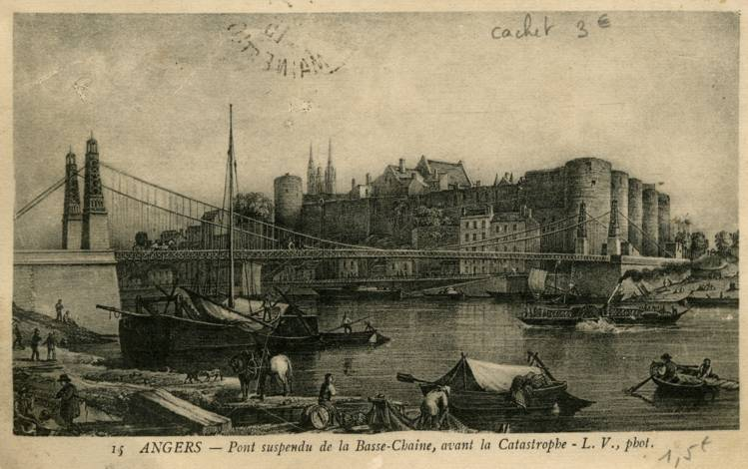
Angers Bridge over river Maine in France
Collapsed under weight of marching troops, April 16, 1850, killing more than 200 soldiers.

Slide 27
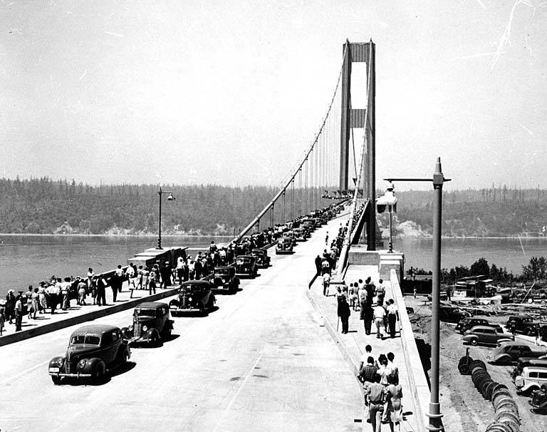
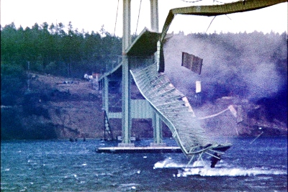
Tacoma Narrows Bridge
Opening day, July 1, 1940
Collapse, November 7, 1940
The Tacoma Narrows Bridge is a mile-long (1600 meter) suspension bridge with a main span of 850 m (the third-largest in the world when it was first built) that carries Washington State Route 16 across the
Tacoma Narrows of Puget Sound from Tacoma to Gig Harbor, Washington (collapsed in wind, 1940)
http://www.enm.bris.ac.uk/anm/tacoma/tacoma.html

Slide 28
Coupled Oscillations

Slide 29
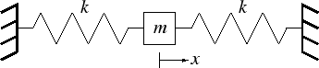
One mass+ Two springs
One mass+ Many springs
k₂
k₁
m
k₃
k₄

Slide 30
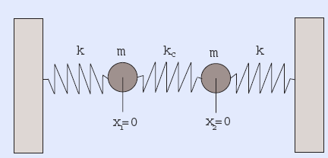
Two mass, three spring (coupled oscillator)
SHM term
Coupling term

Slide 31
Let
Natural freq. of each spring-mass
Adding
Subtracting

Slide 32
Normal Co-ordinates
Normal modes

Slide 33
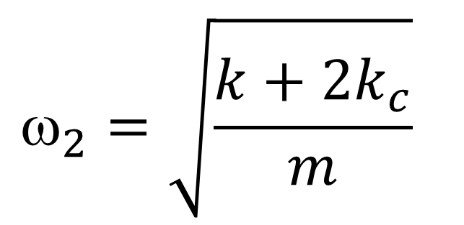
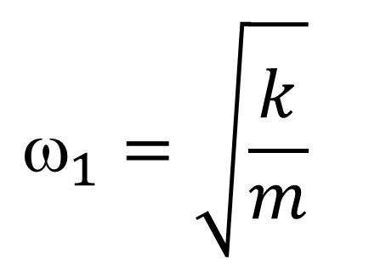
Normal mode frequencies
$$_{1}=\sqrt{\frac{k}{m}}$$
$$_{2}=\sqrt{\frac{k+2k_{c}}{m}}$$

Slide 34
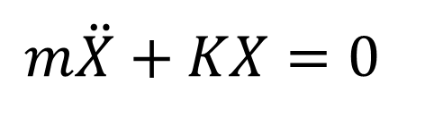
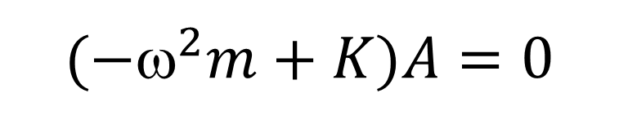
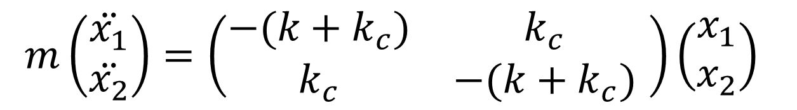
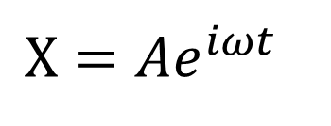
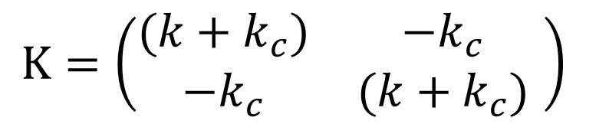
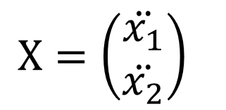
Alternatively
$$m\left(\begin{matrix}\ddot{x_{1}} \\ \ddot{x_{2}}\end{matrix}\right)=\left(\begin{matrix}−(k+k_{c}) & k_{c} \\ k_{c} & −(k+k_{c})\end{matrix} \right)\left(\begin{matrix}x_{1} \\ x_{2}\end{matrix}\right)$$
$$m\ddot{X}+KX=0$$
$$X=\left(\begin{matrix}\ddot{x_{1}} \\ \ddot{x_{2}}\end{matrix}\right)$$
$$K=\left(\begin{matrix}(k+k_{c}) & {−k}_{c} \\ {−k}_{c} & (k+k_{c})\end{matrix} \right)$$
Trial solution:
$$X=Ae^{iωt}$$
(A – Amplitude vector)
$$(−^{2}m+K)A=0$$

Slide 35
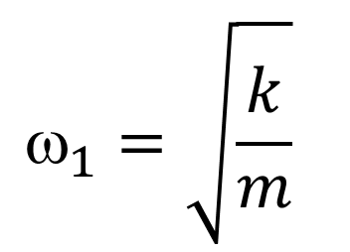
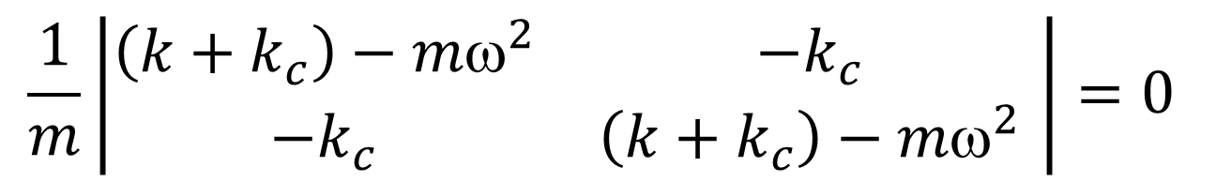
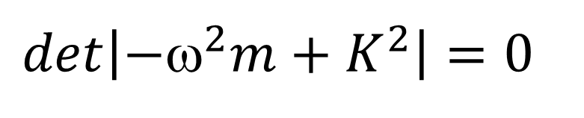
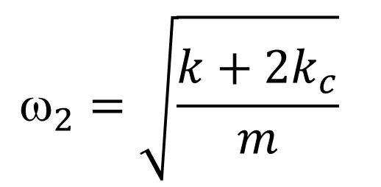
For non-trivial solution of X:
$$det\left|−ω^{2}m+K^{2}\right|=0$$
$$\frac{1}{m}\left|\begin{matrix}\left(k+k_{c}\right)−{mω}^{2} & {−k}_{c} \\ {−k}_{c} & \left(k+k_{c}\right)−{mω}^{2}\end{matrix} \right|=0$$
$$_{1}=\sqrt{\frac{k}{m}}$$
$$_{2}=\sqrt{\frac{k+2k_{c}}{m}}$$

Slide 36
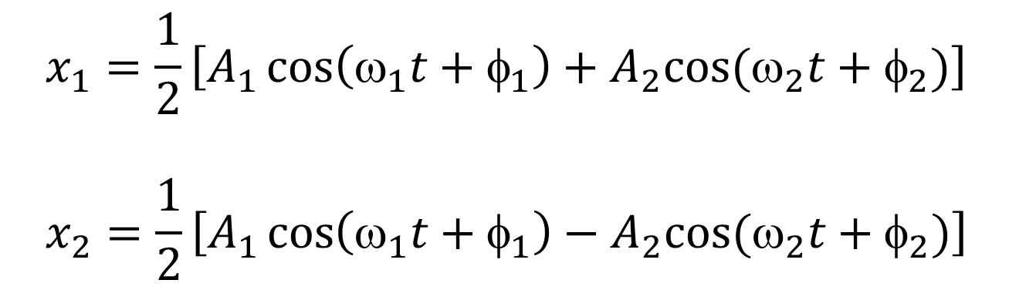
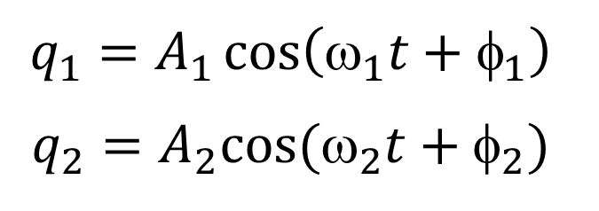
Solutions:
$$q_{1}=A_{1}\cos\left(ω_{1}t+φ_{1}\right)$$
$$q_{2}=A_{2}cos⁡(_{2}t+_{2})$$
$$x_{1}=\frac{1}{2}\left[A_{1}\cos\left(ω_{1}t+φ_{1}\right)+A_{2}cos⁡(ω_{2}t+φ_{2})\right]$$
$$x_{2}=\frac{1}{2}\left[A_{1}\cos\left(ω_{1}t+φ_{1}\right)−A_{2}cos⁡(ω_{2}t+φ_{2})\right]$$

Slide 37
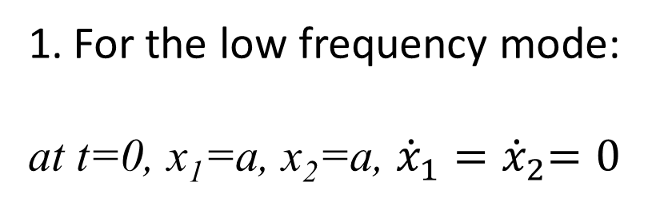
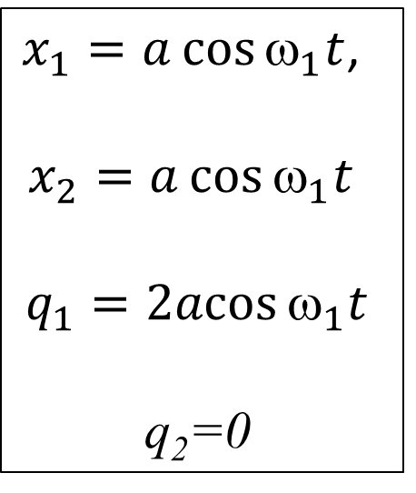
To selectively excite a normal mode…
For the low frequency mode:
at t=0, x₁=a, x₂=a, ${\dot{x}}_{1}{=\dot{x}}_{2}=0$
$x_{1}=a\cos{ω_{1}t}$,
$x_{2}=a\cos{ω_{1}t}$
$$q_{1}=2acos{_{1}t}$$
q₂=0

Slide 38
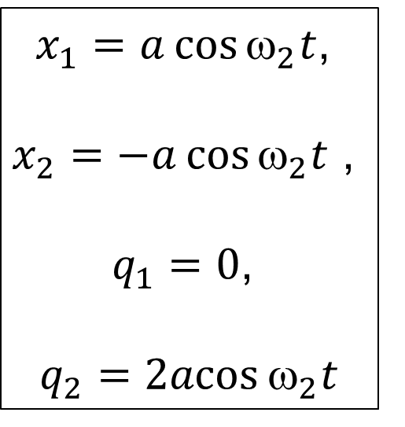
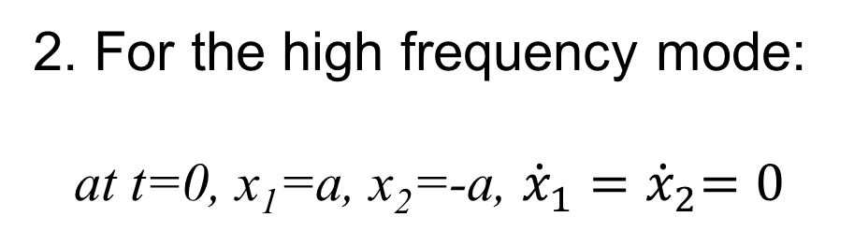
2. For the high frequency mode:
at t=0, x₁=a, x₂=-a, ${\dot{x}}_{1}{=\dot{x}}_{2}=0$
$x_{1}=a\cos{ω_{2}t}$,
$x_{2}=−a\cos{ω_{2}t}$ ,
$q_{1}=0$,
$$q_{2}=2acos{_{2}t}$$

Slide 39
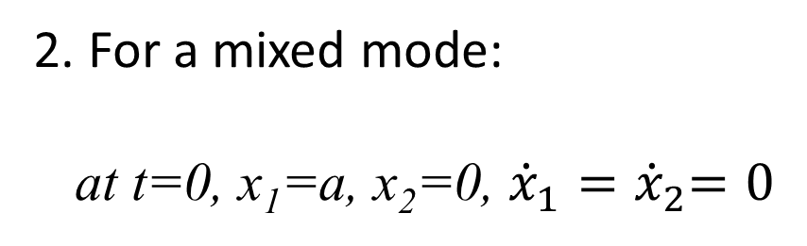
2. For a mixed mode:
at t=0, x₁=a, x₂=0, ${\dot{x}}_{1}{=\dot{x}}_{2}=0$

Slide 40
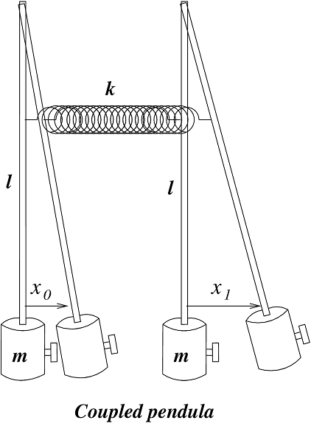
Example: Coupled Pendula
Equation of motion
SHO Coupling
term term
With assumption

Slide 41
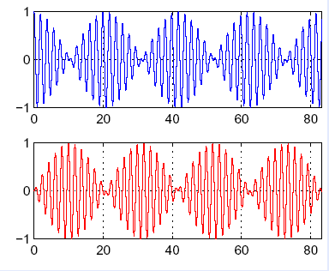
Example: Coupled Pendula, mixed mode
T_{c}
x₁
Behavior with time for individual pendulum
T_{B}/2
x₂
t
x₁(0) = 0 and x₂(0) = 1

Slide 42
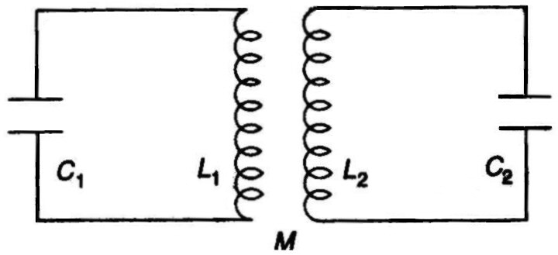
Coupled Oscillator
From Pain

Slide 43
Solving
Where
k: Coefficient of Coupling

Slide 44
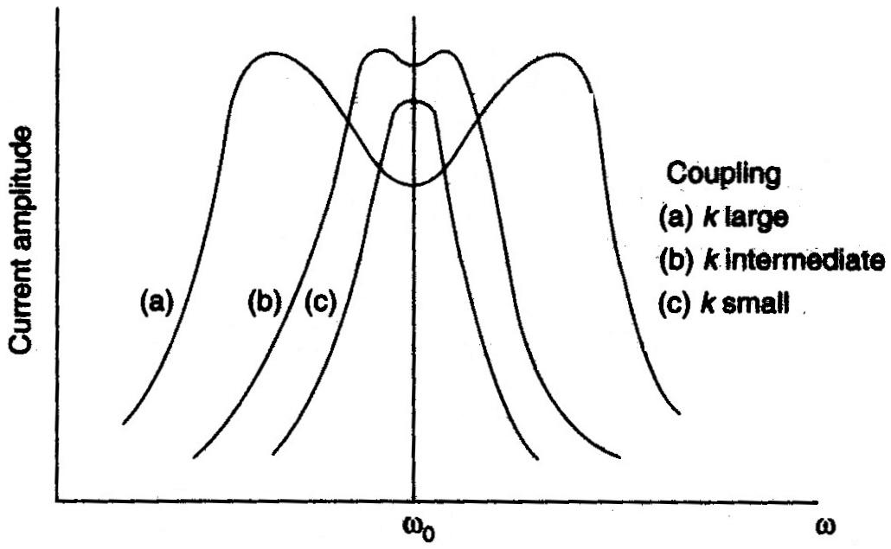
Variation of the current amplitude in each circuit
near the resonant frequency
From Pain

Slide 45
Electrical Analog of Mechanical properties
General Characteristics | Mechanical properties | Electrical property
Indep. variable Dep. Variable Inertia Resistance Stiffness | Time (t) Position (x) Mass (m) Drag coeff. Stiffness (k)
Time (t)
Charge (q)
Inductance (L)
Resistance
(Capacitance)⁻¹

Slide 46

Resonant frequency
Period
Figure of merit
$$Q=\frac{ω_{0}}{2β}$$

Slide 47


Continuous limit: wave equations
x_{n-1}
x_{n}
x_{n+1}
…
k
k
k
k
In continuous limit, index i may be replaced by x and the
variable x may be replaced by a variableΨ(x,t)

Slide 48



Longitudinal wave: Elastic rod
ρ density, Y- Young’s modulus
Cross section: A
t=0
x
x+Δx
t >0
x+Ψ
x+Δx+Ψ+ΔΨ
$$Y=\frac{\frac{F}{A}}{\frac{ΔΨ}{Δx}}$$
$$F=\left(\frac{YA}{Δx}\right)ΔΨ$$
$$k=\left(\frac{YA}{Δx}\right)$$

Slide 49





$x_{n+1}−$ $x_{n}=\frac{Ψ\left(x+x,t\right)−Ψ(x,t)}{x}x={\left(\frac{∂Ψ}{∂x}\right)}_{|x+x}.x$
$x_{n}−$ $x_{n−1}=\frac{Ψ\left(x,t\right)−Ψ(x+Δx,t)}{Δx}Δx={\left(\frac{∂Ψ}{∂x}\right)}_{|x}.Δx$
L.H.S.: ρ$AΔx\frac{∂^{2}Ψ}{∂t^{2}}$
R.H.S: $\left(\frac{YA}{Δx}\right)∗\left[{\left(\frac{∂Ψ}{∂x}\right)}_{|x+Δx}−{\left(\frac{∂Ψ}{∂x}\right)}_{|x}\right].Δx=YAΔx\frac{∂^{2}Ψ}{∂x^{2}}$
$$\frac{∂^{2}Ψ}{∂x^{2}}\text{=}\frac{ρ}{Y}\frac{∂^{2}Ψ}{∂t^{2}}$$
(Longitudinal Wave
equation)

Slide 50




Transverse wave: Stretched string

Slide 51





R.H.S:
L.H.S:

Slide 52




Solution to wave equation
Plane wave: General Solution
$$ \left(x,t\right)=a_{1}f\left(x+vt\right)−a_{2}f(x−vt)$$
(General form)
$$ \left(x,t\right)=acos\left[kx−ωt+δ\right]$$
(Sinusoidal)
Spherical wave (three dimensions): General Solution
$$ \left(r,t\right)=a_{1}\frac{f\left(r+vt\right)}{r}+a_{2}\frac{f(r−vt)}{r}$$
(General form)
$$ \left(r,t\right)=\frac{a}{r}cos\left[kr−ωt+δ\right]$$
(Sinusoidal)

Slide 53
Propagation of Wave

Slide 54


Slide 55


Slide 56


Slide 57


Slide 58


Slide 59


Slide 60


Slide 61

Phase Velocity
Group Velocity
Phase Velocity
Group Velocity

Slide 62
Mathematical Physics

Slide 63
Taylor Series
For any regular infinitely differentiable function,
The trigonometric functions can thus be expressed as

Slide 64
Second order ordinary differential equations
We can write any regular, continuous, infinitely
differentiable function as
Substituting this in the differential equation
We get,
Equating powers of t^{n} , we can write

Slide 65
Solutions of ODE
We now apply boundary conditions to get the solutions

Slide 66
Phase
Most general solution
A and B can be transformed to C and

